Slide 1
Robotics & Design Interdisciplinary course
Presentation title
Group n° 3 (Ritter, Vignati, Fochetta, Sardella, Anastasovski, Bendit)

Slide 2
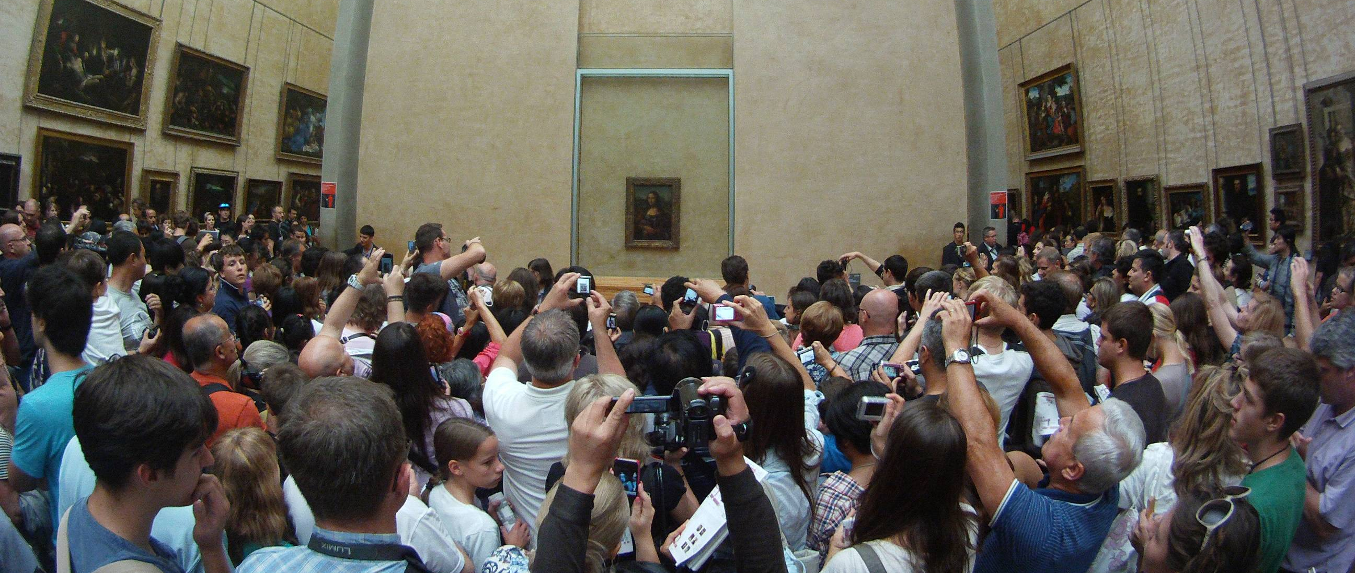
Goal
Our goal is to imagine, design and realize a robot that can attract the attention of people passing by a restaurant.
We want them to look at the menu and possibly come inside.

Slide 3
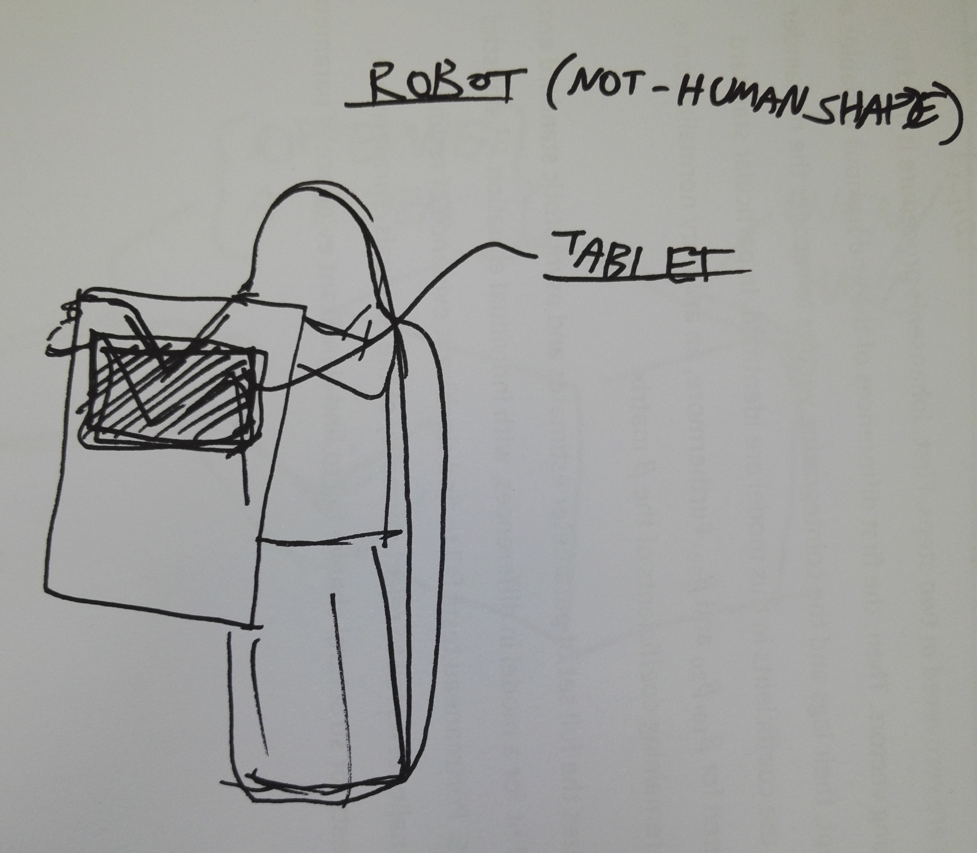
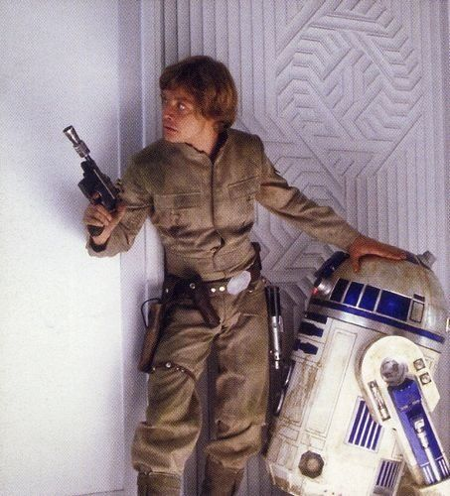
The ten alternatives
A following robot that walks along with people showing them a tablet with the menu and interacting with them talking and following them

Slide 4
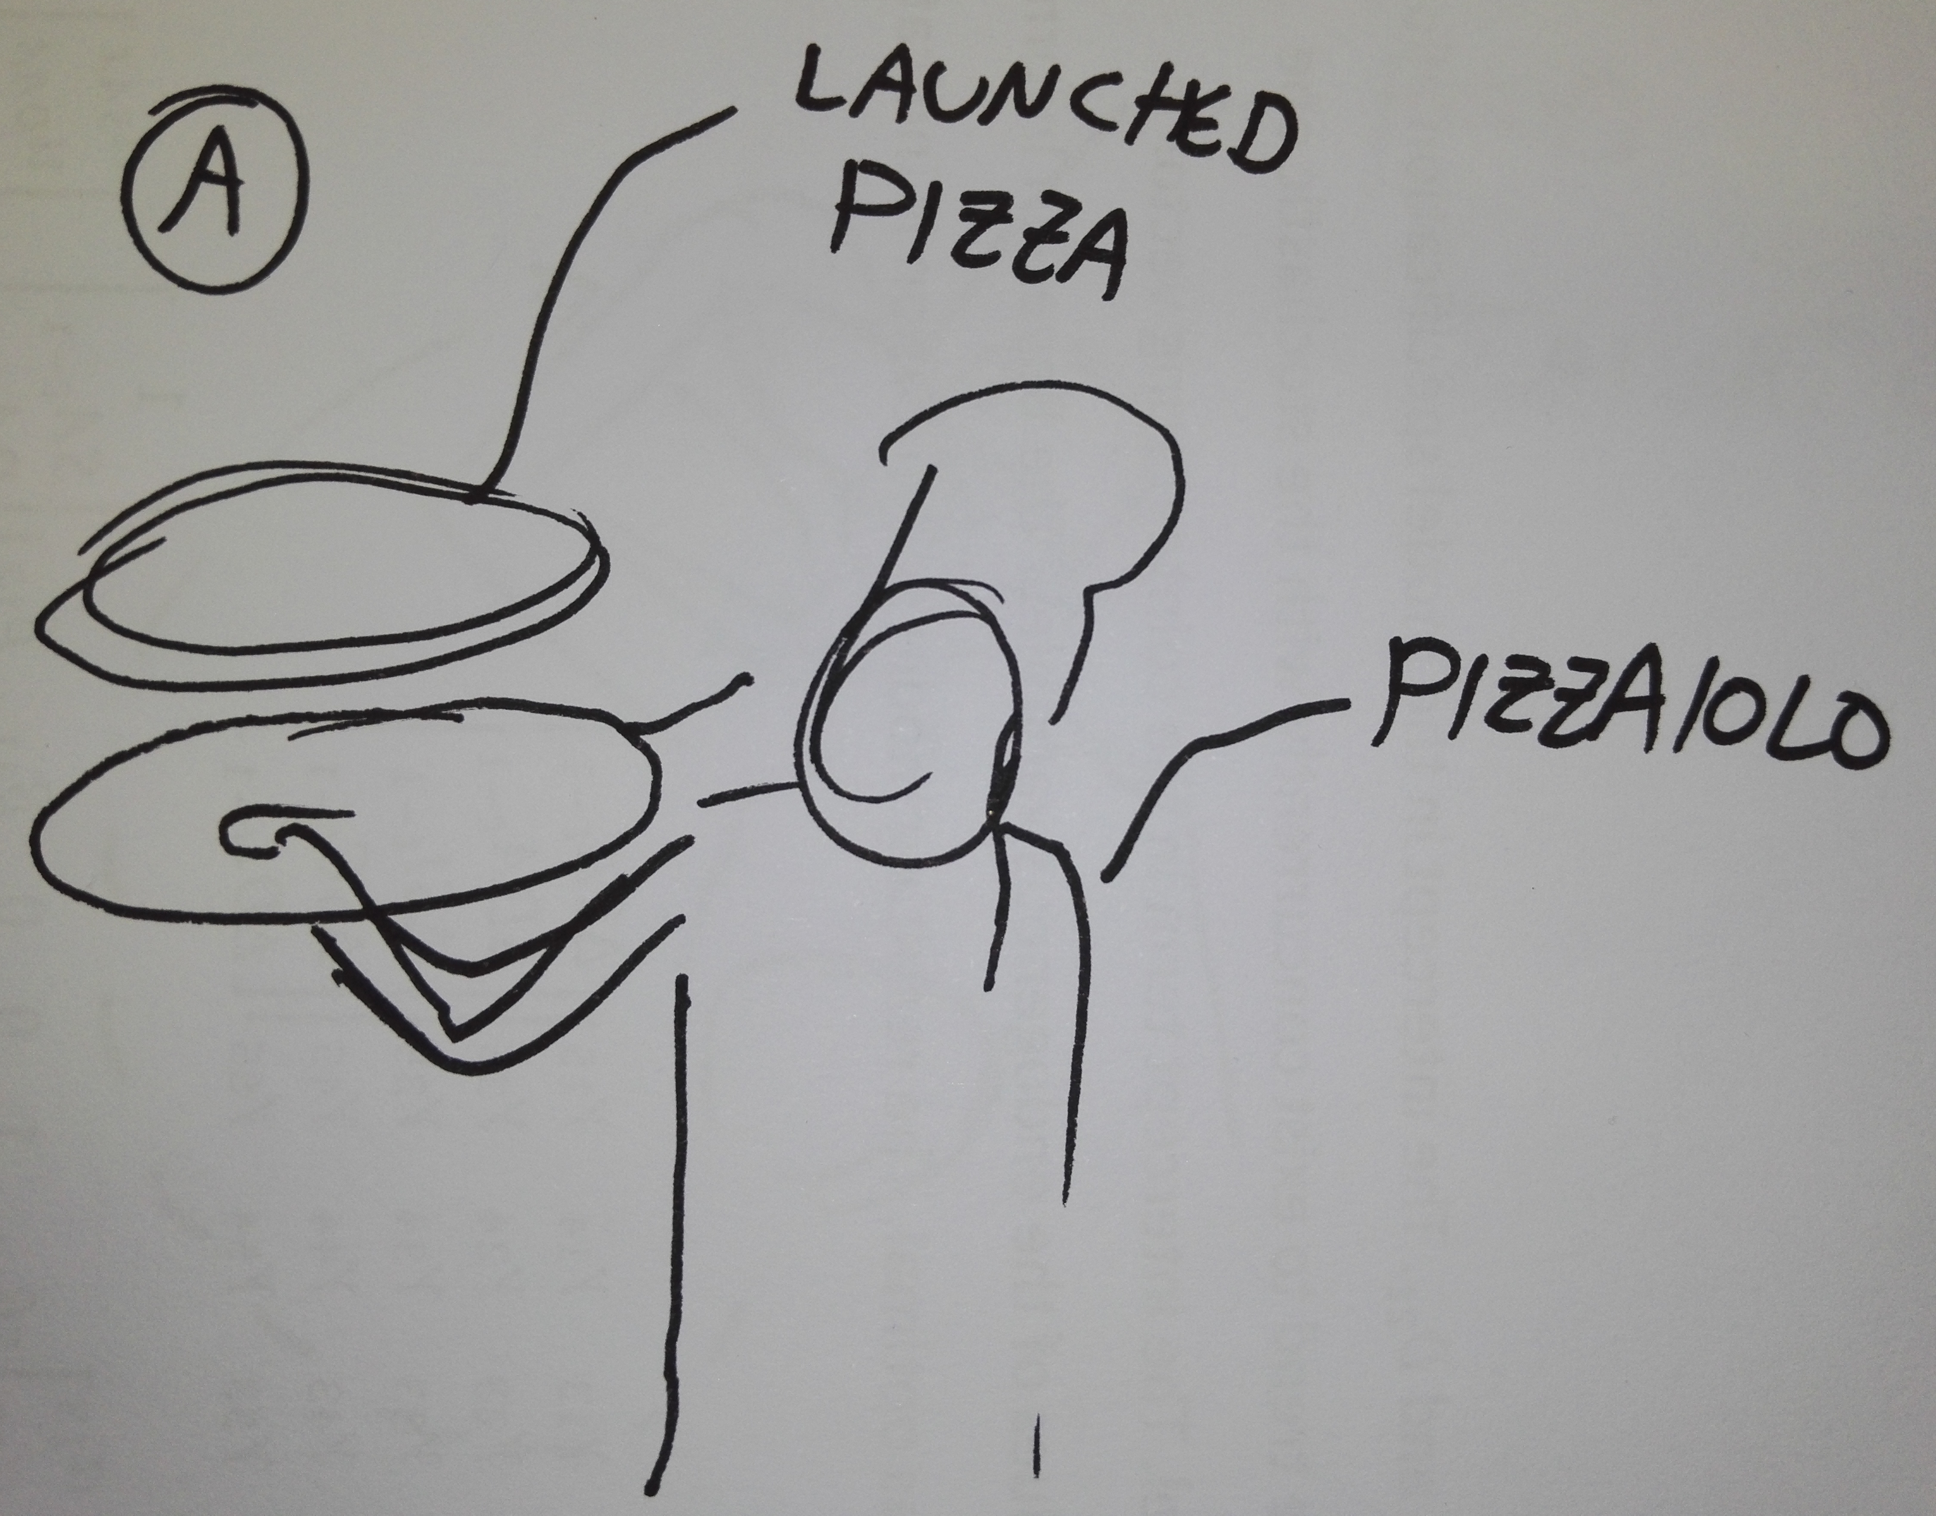
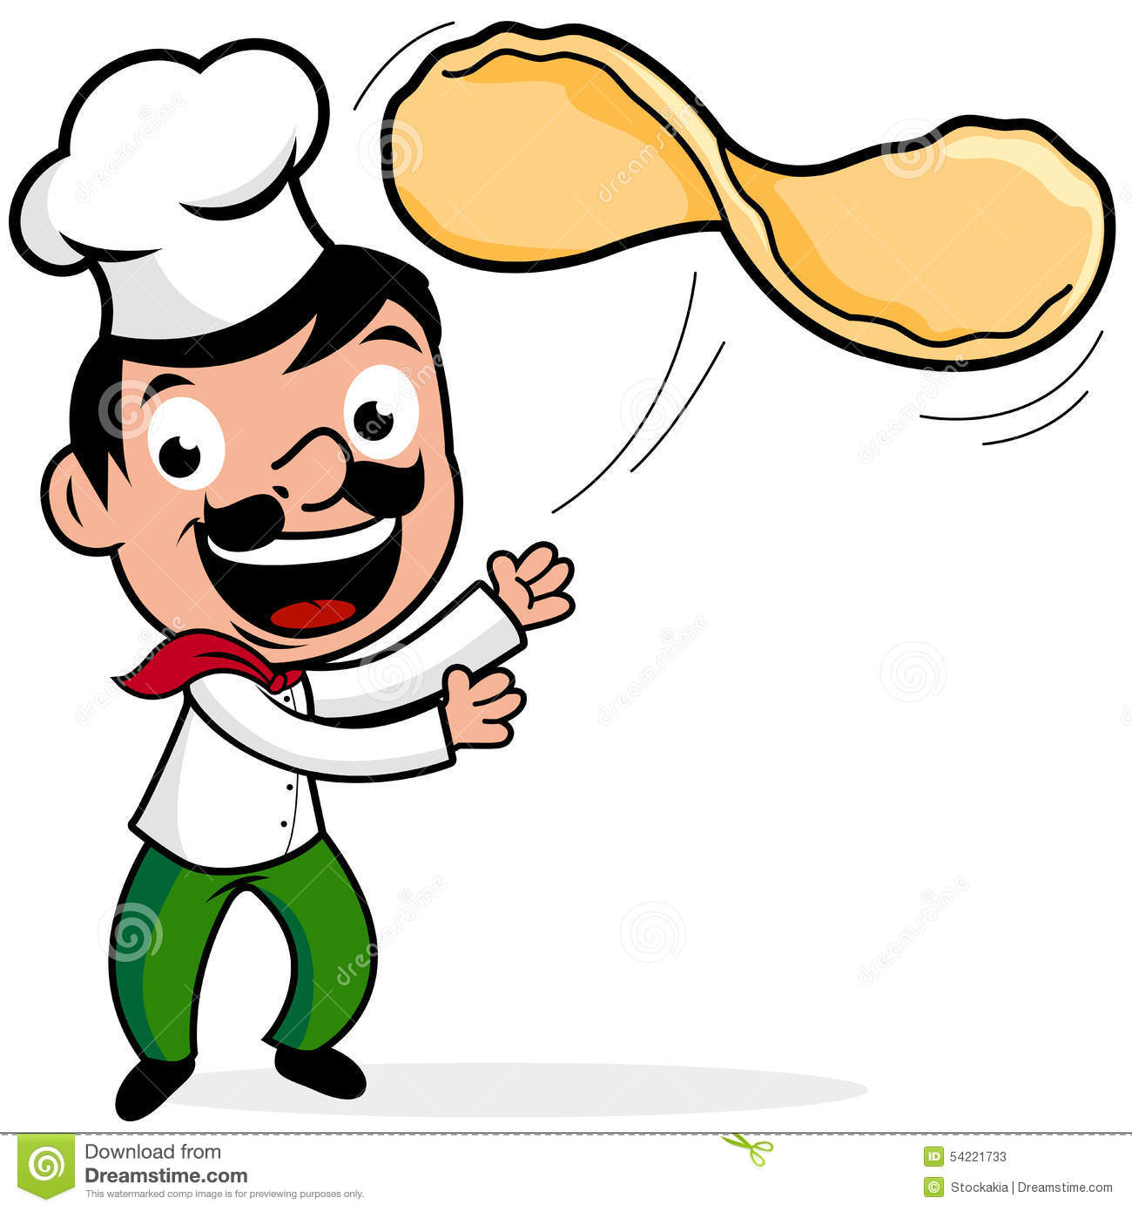
The ten alternatives
A robot that lauches a pizza/piadina imitating the gesture of a pizzaiolo

Slide 5
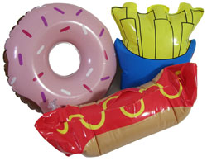
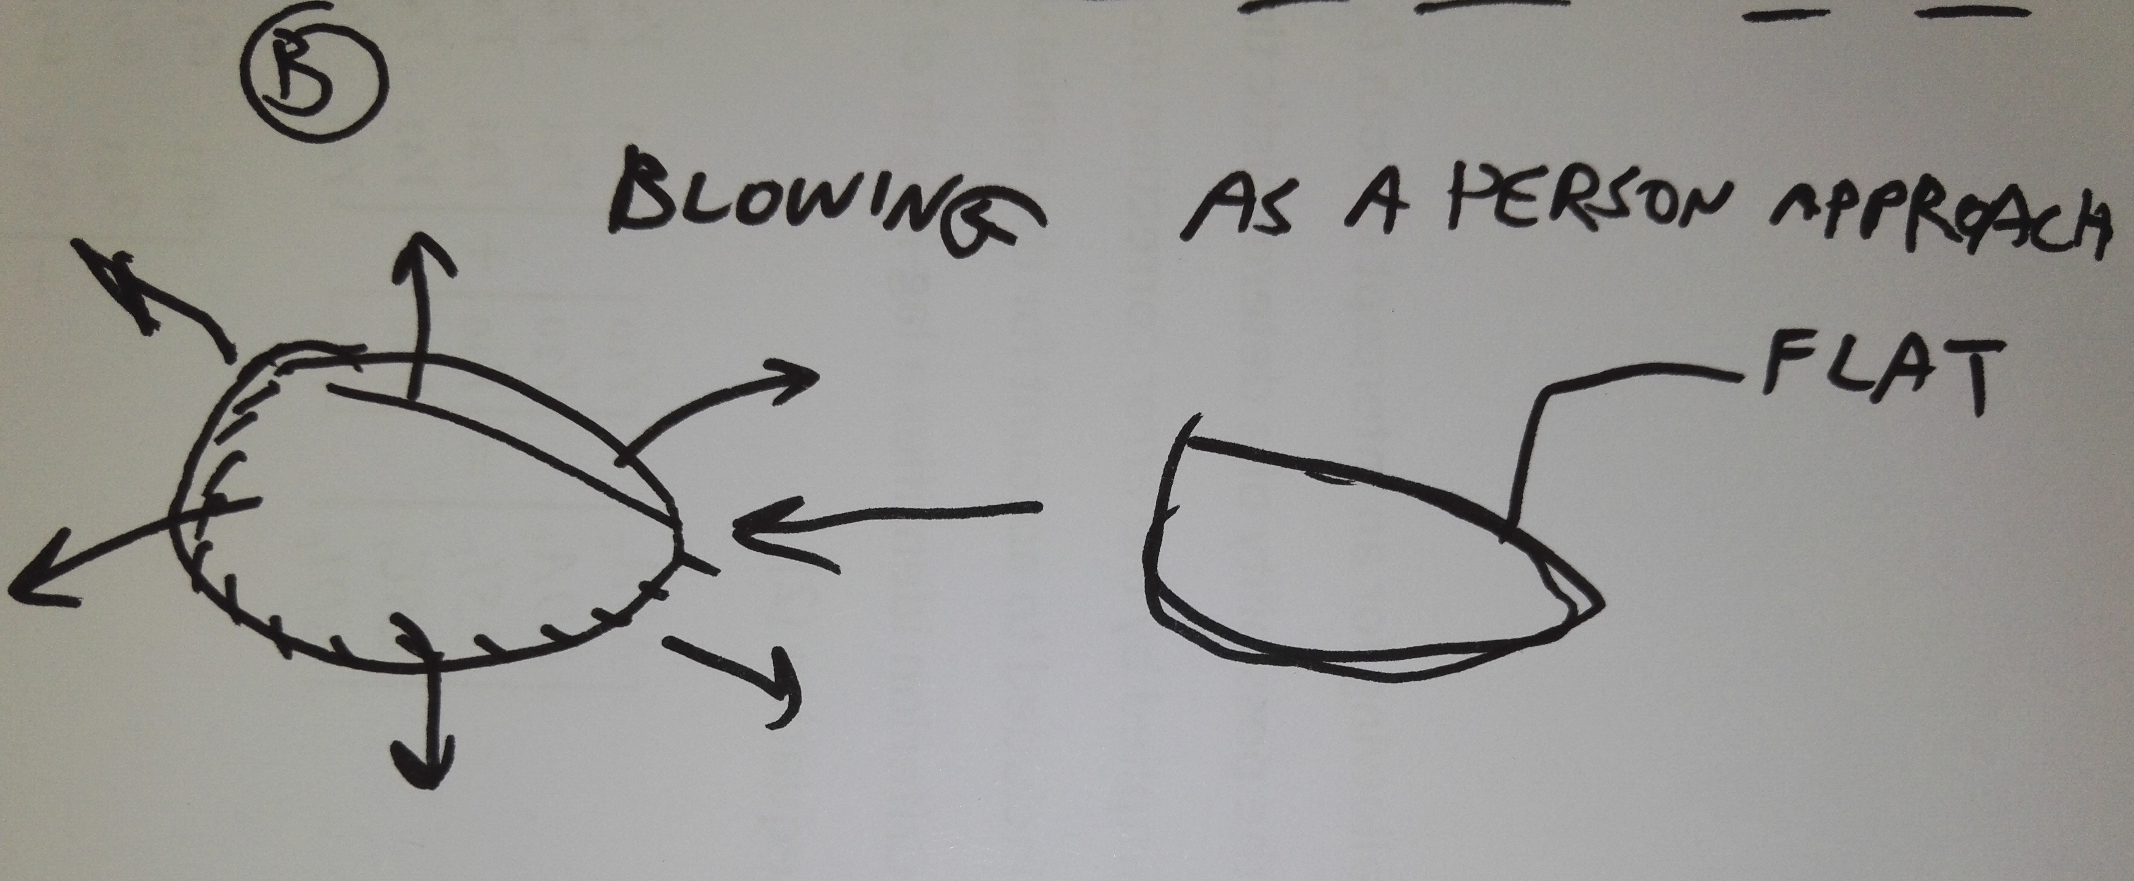
The ten alternatives
A robot that inflates a “bag” shaped like a kind of bakery food (panzerotto, pastasfoglia, croissant) whenever detects someone passing by.

Slide 6
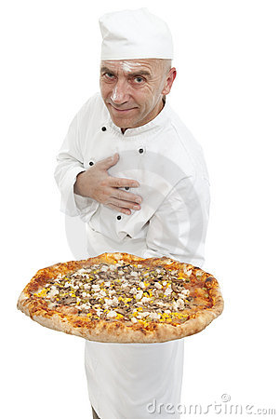
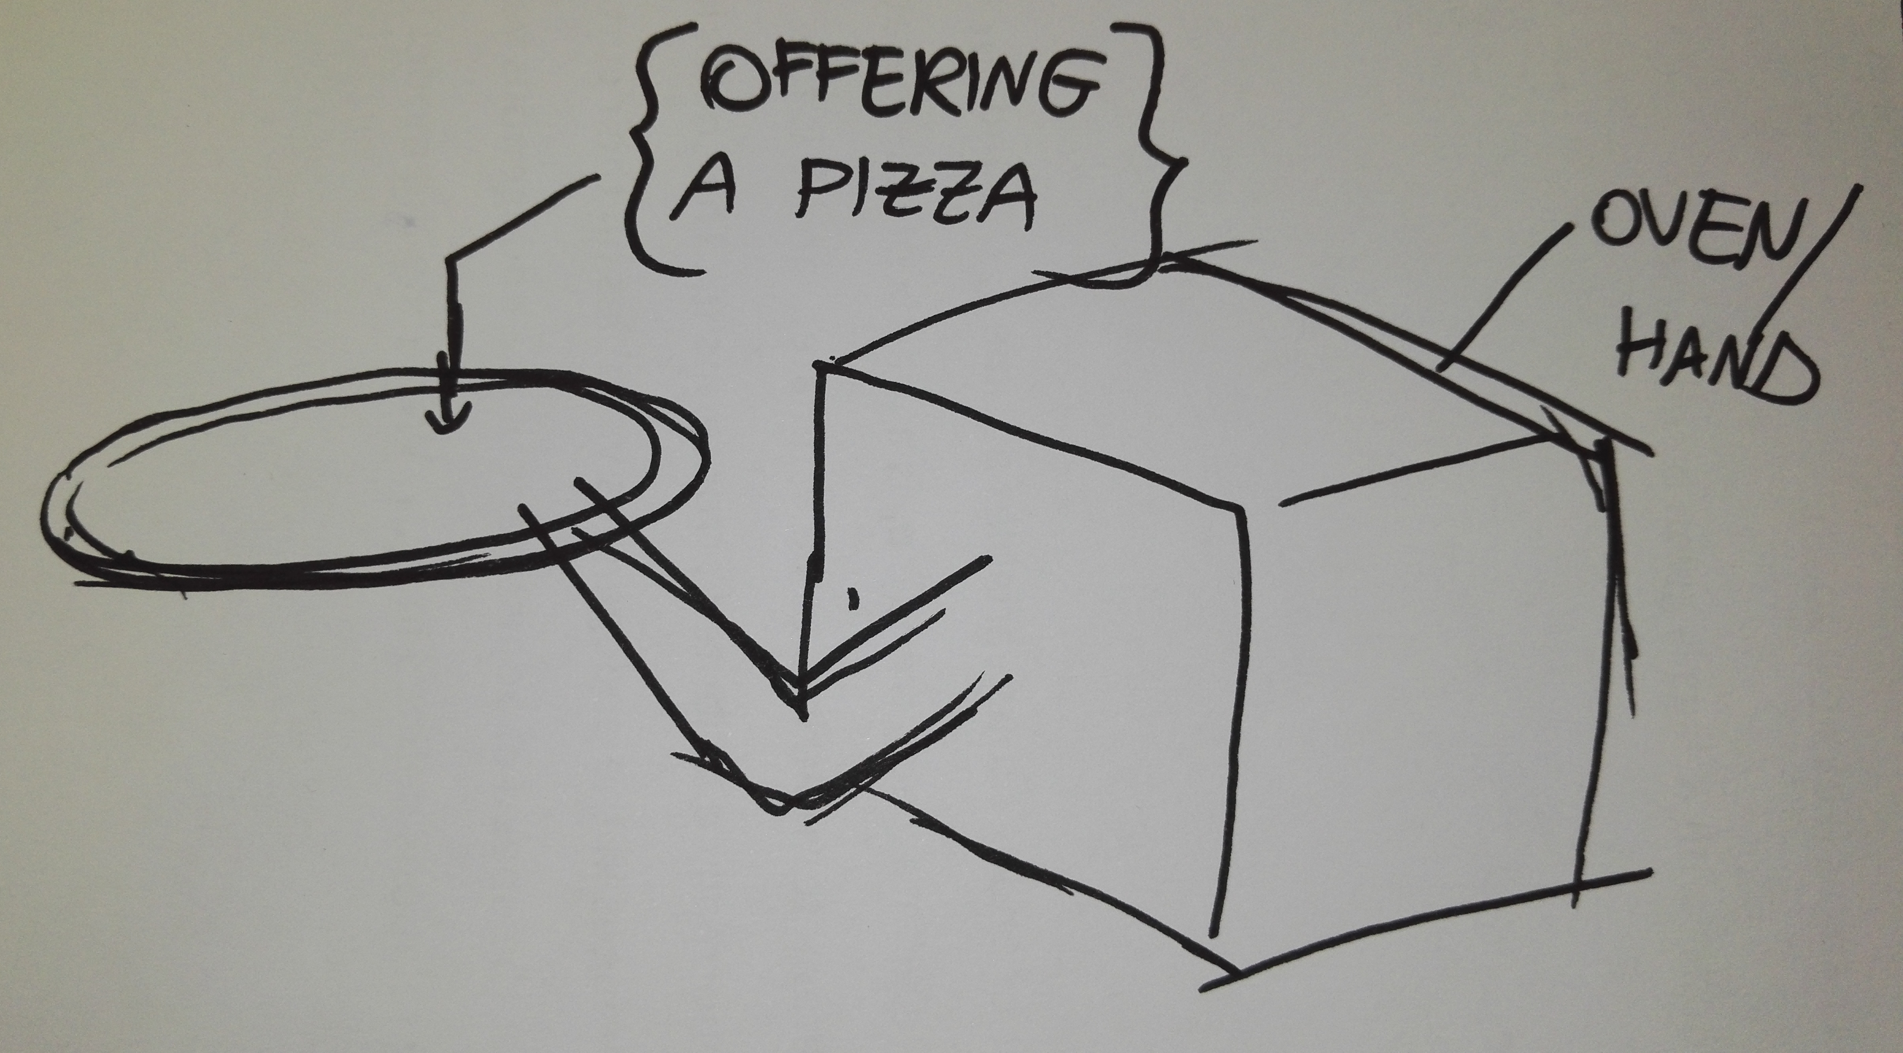
The ten alternatives
A robot that detects people passing by and (based on their position and distance) offers them a dish of food with a telescopic arm.

Slide 7
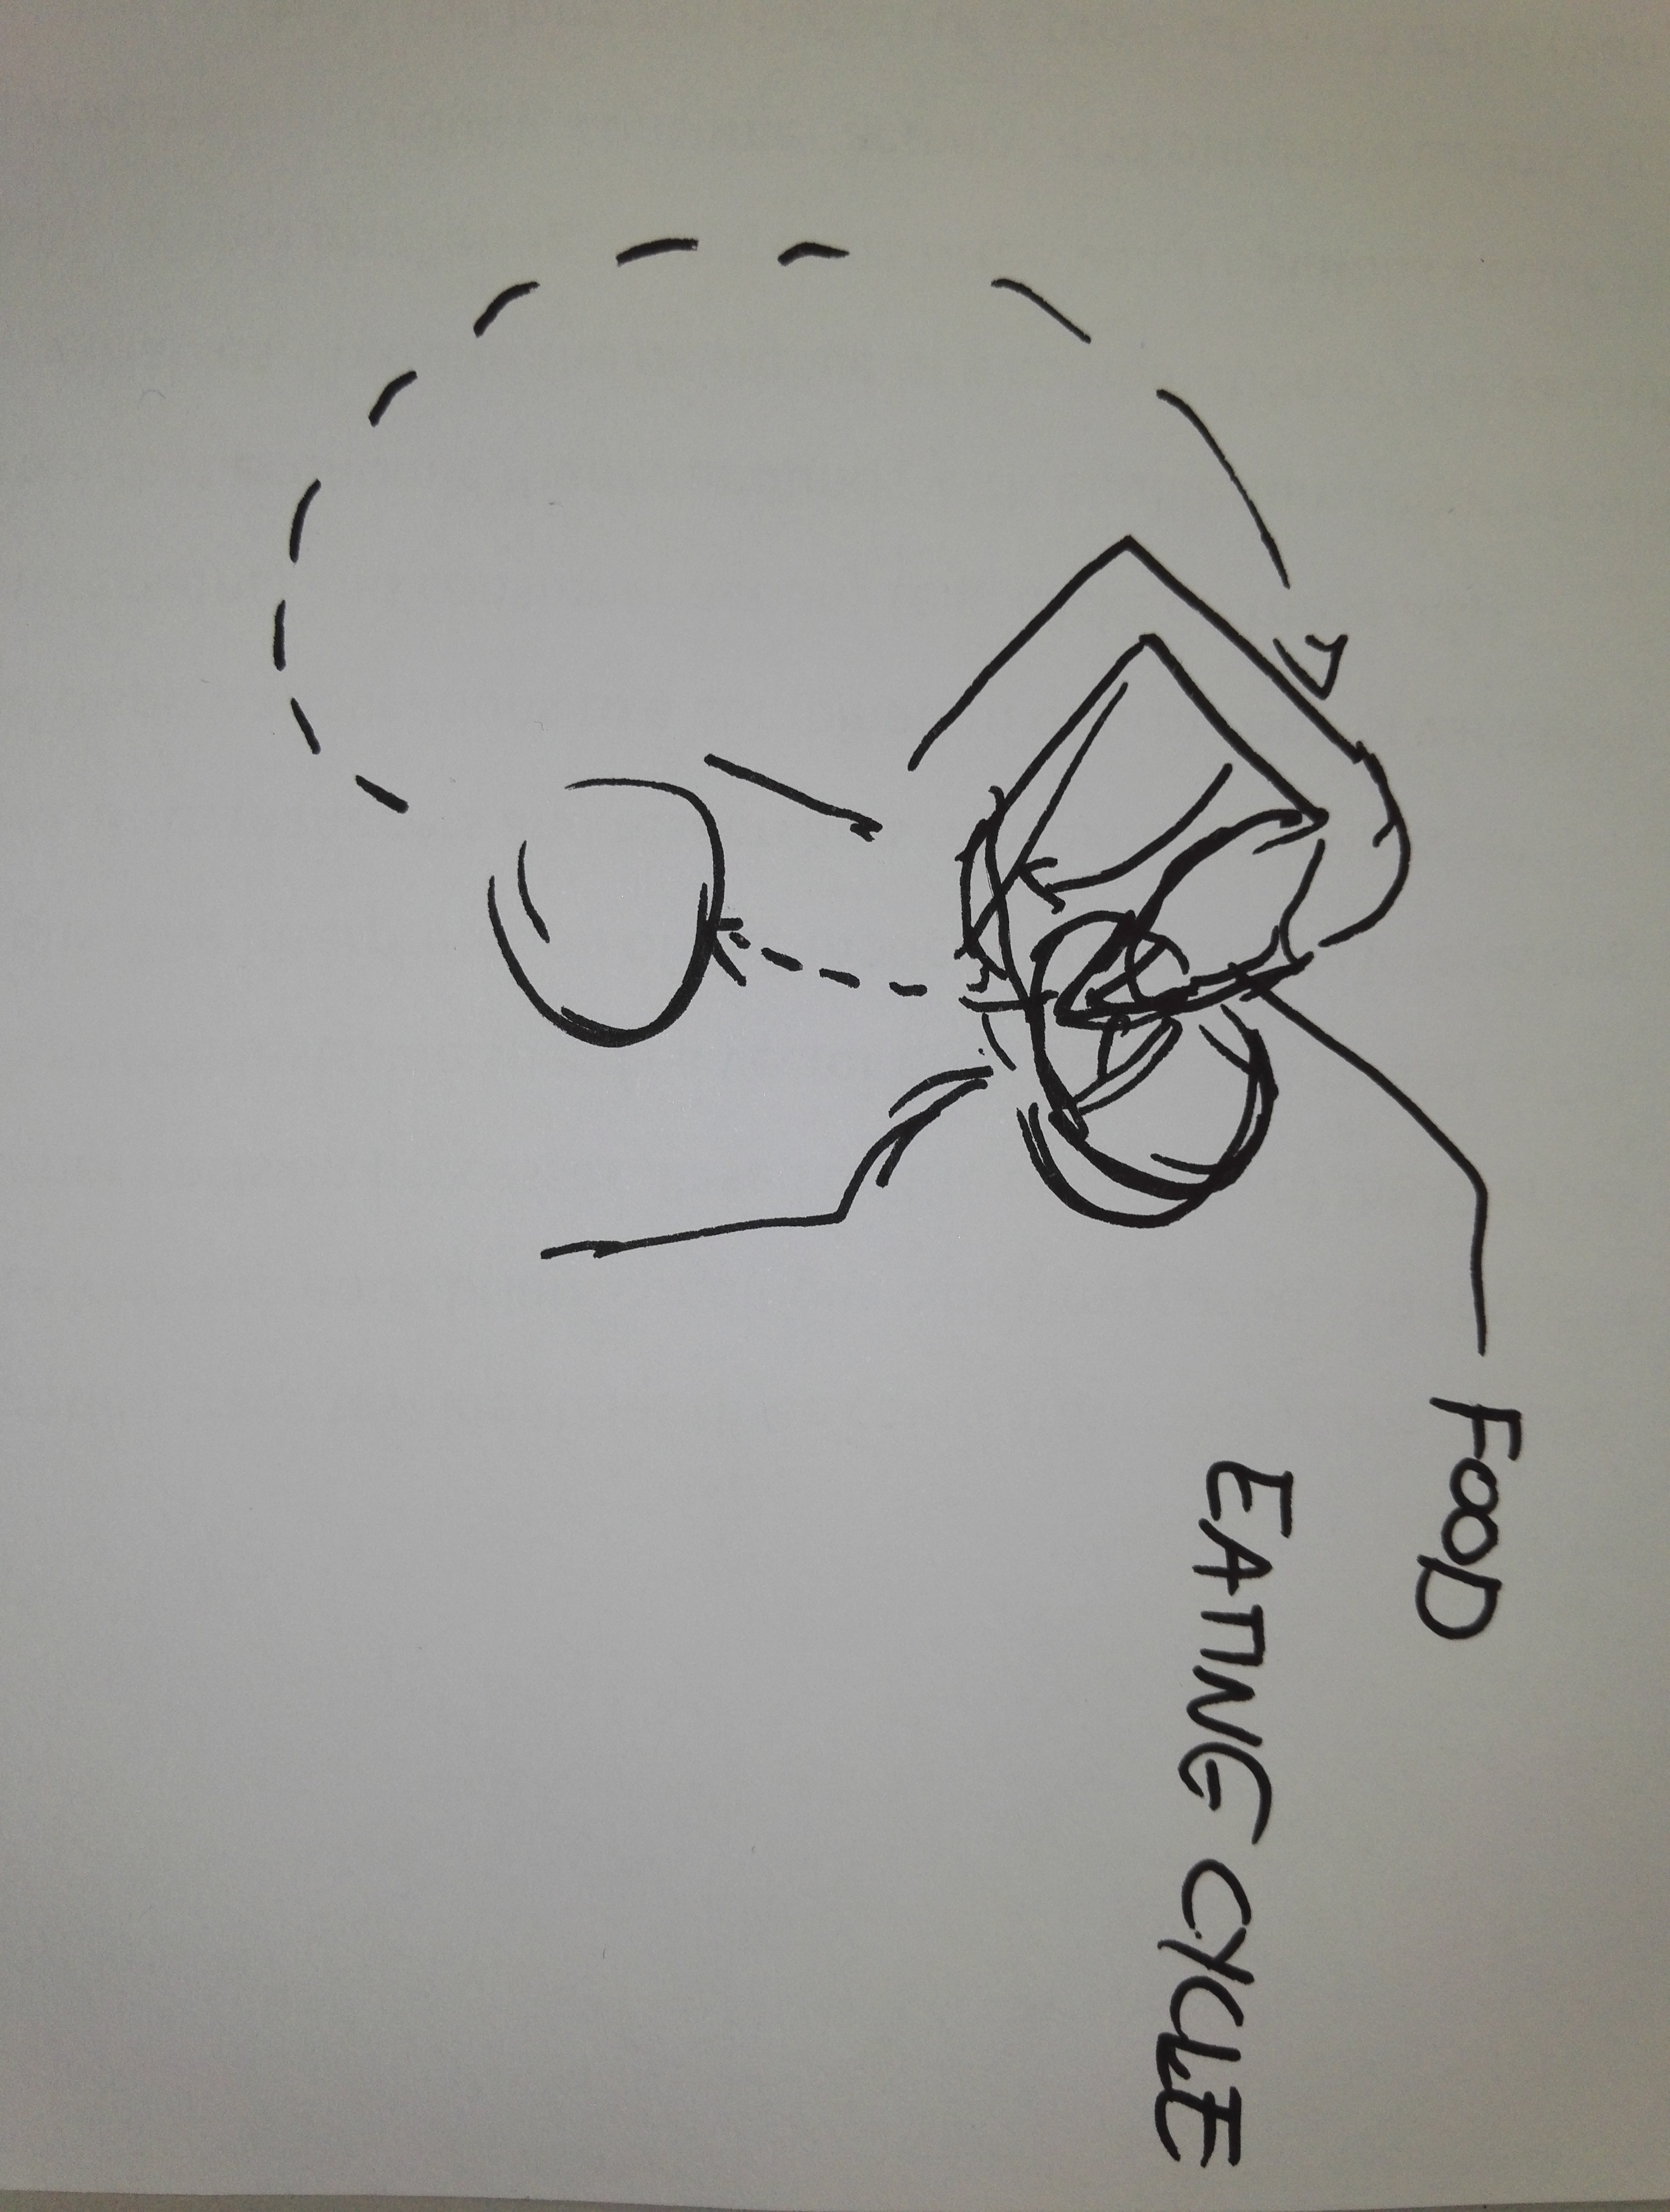
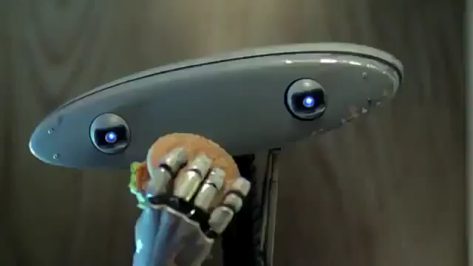
The ten alternatives
A robot that swallows a sandwich or some kind of fast food, then collects it from the back of itself and eats it again and again…

Slide 8
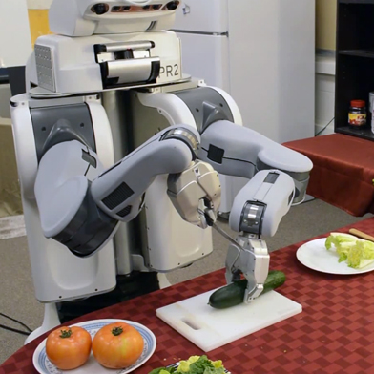
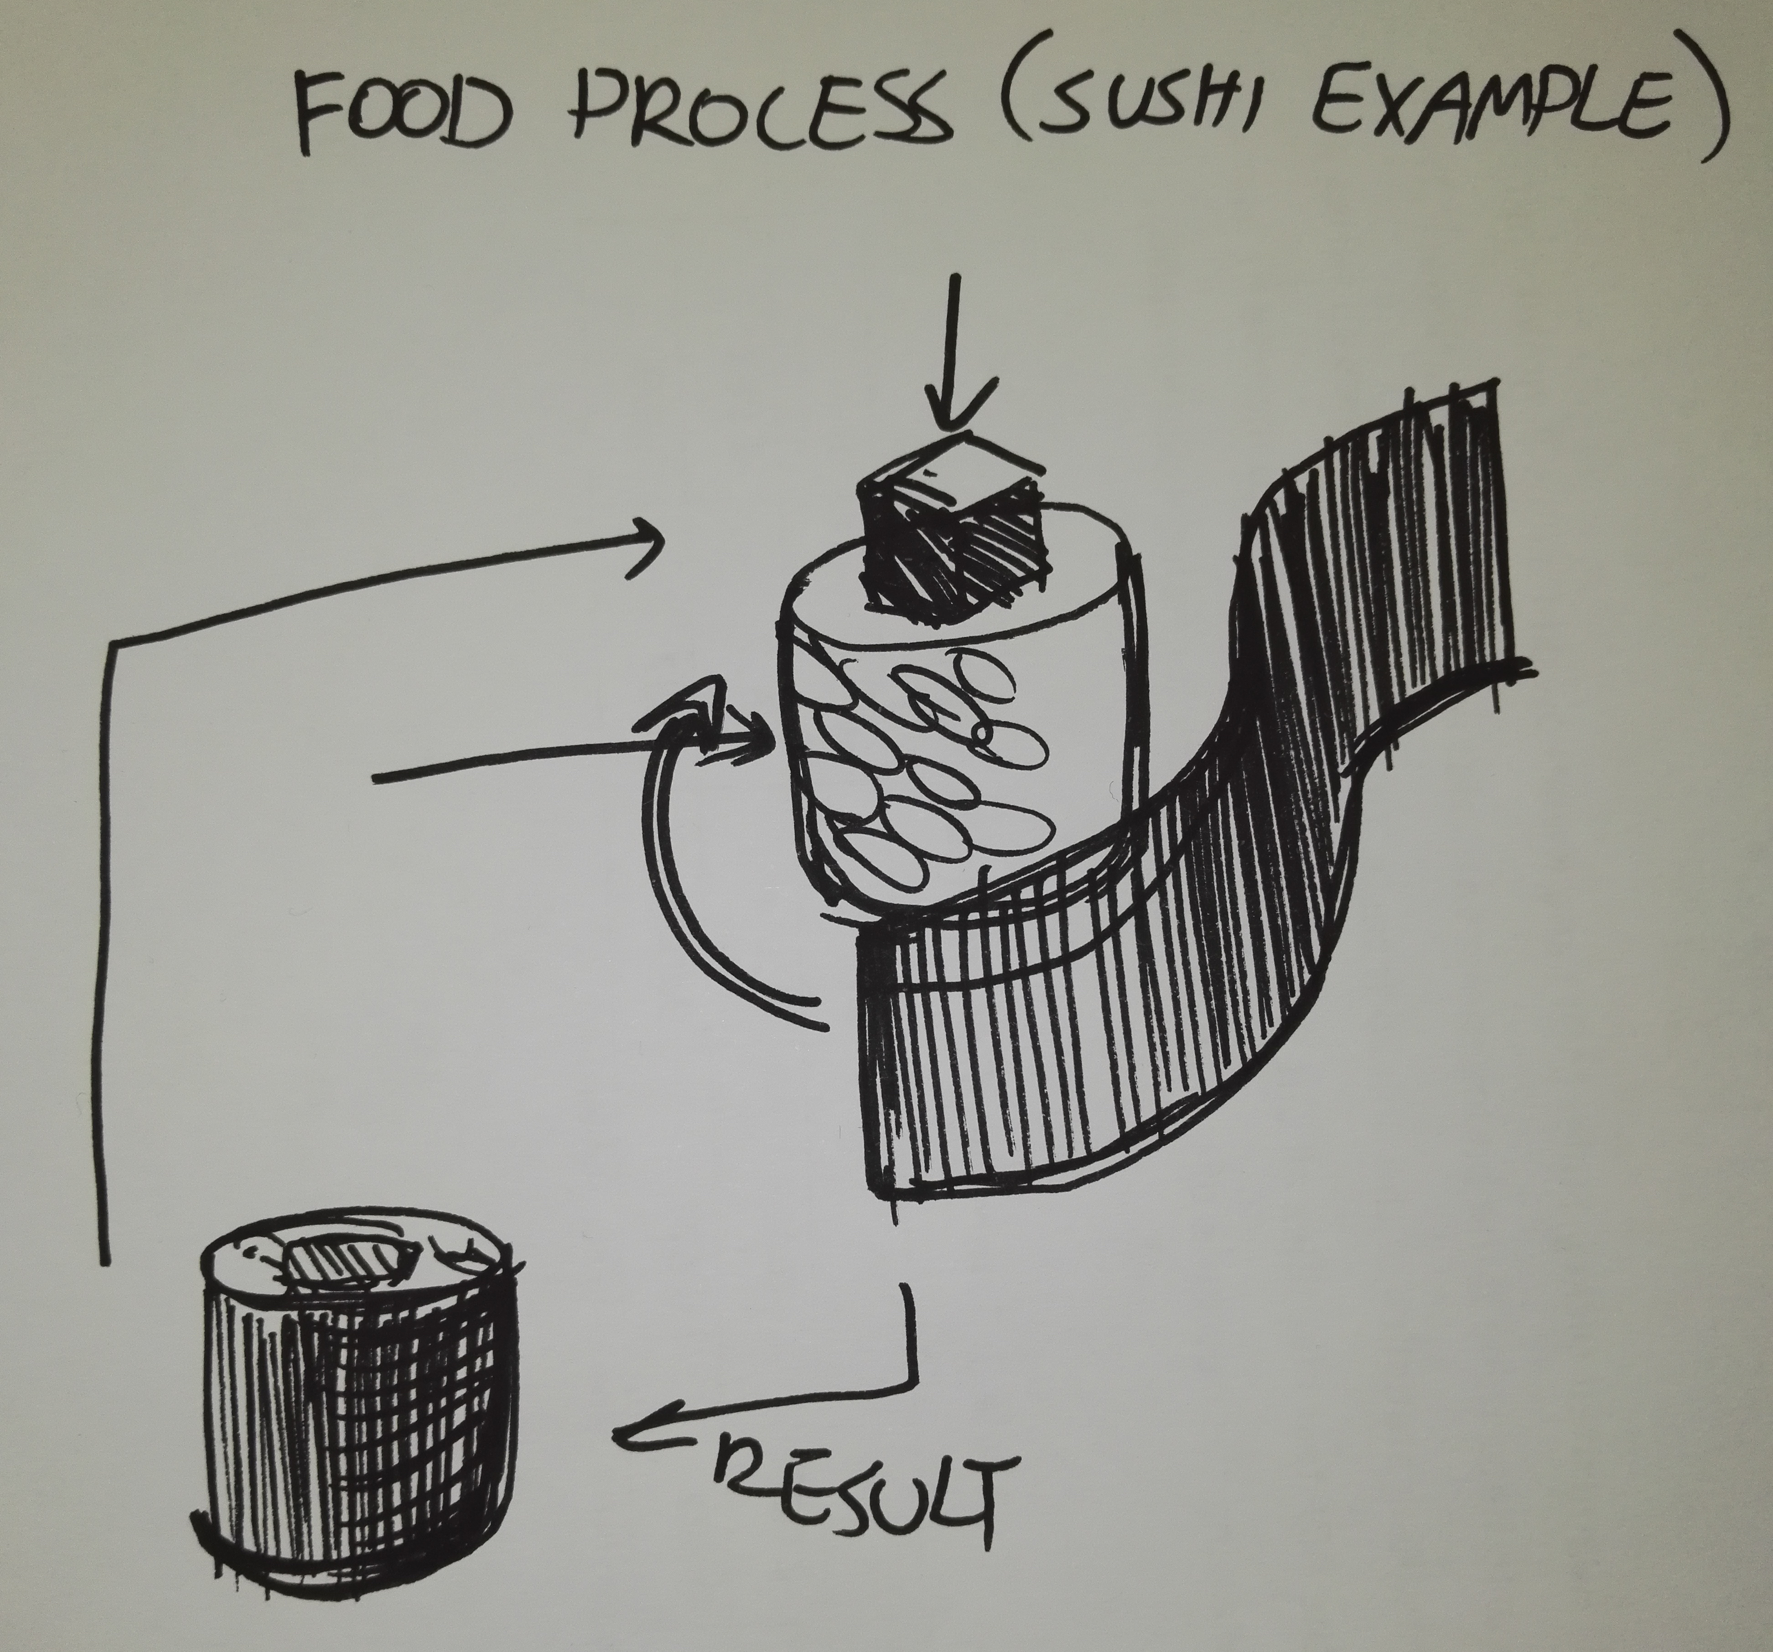
The ten alternatives
A robot that simulates food preparation and processing

Slide 9
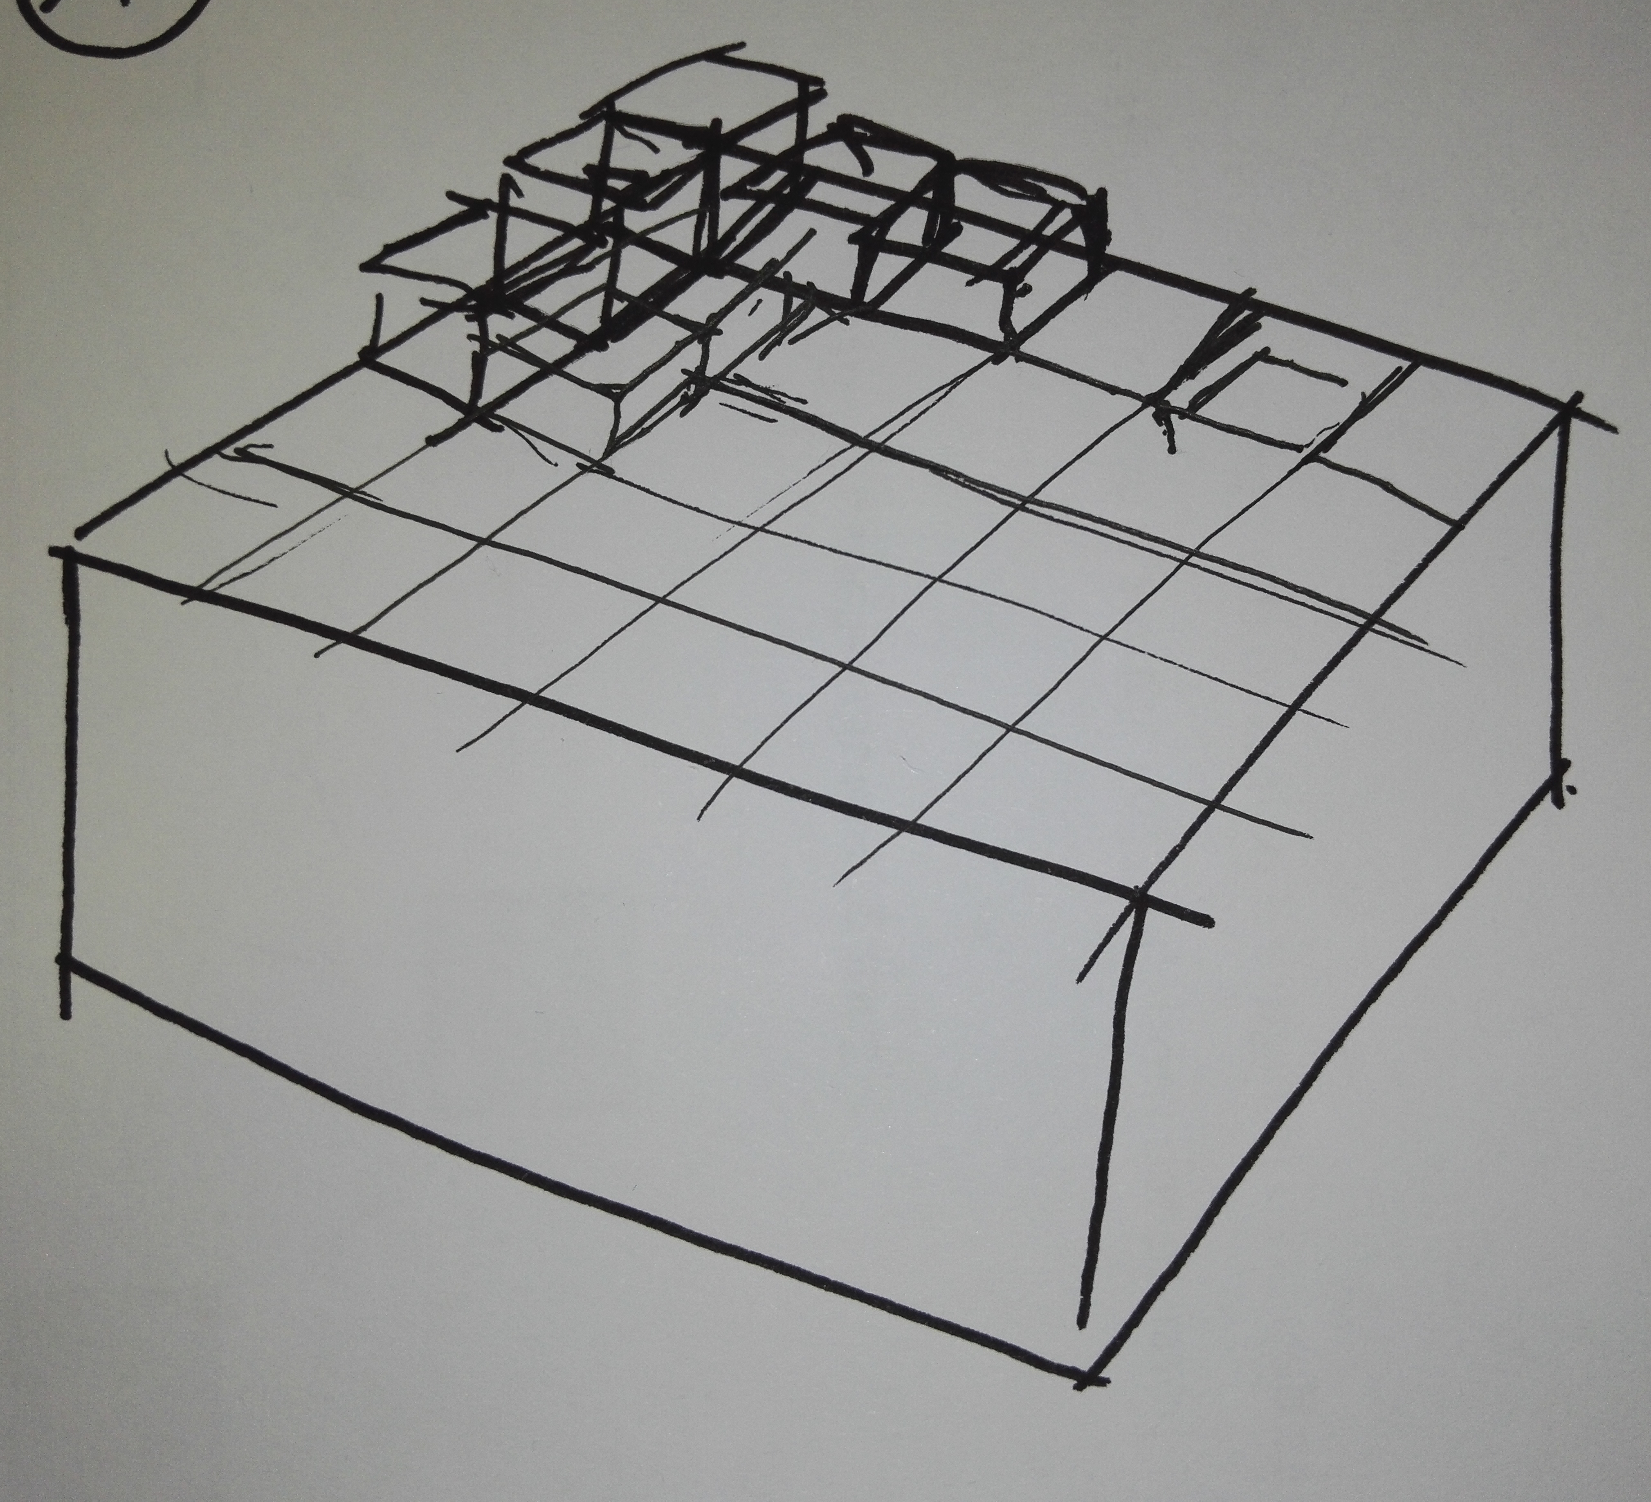
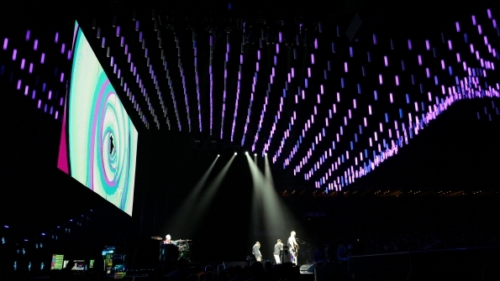
The ten alternatives
A robot that attracts the attention with a movement of a texture made of blocks

Slide 10
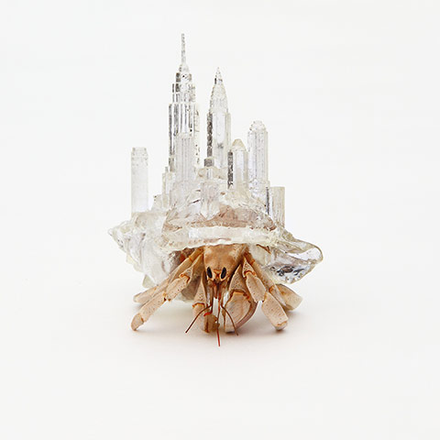
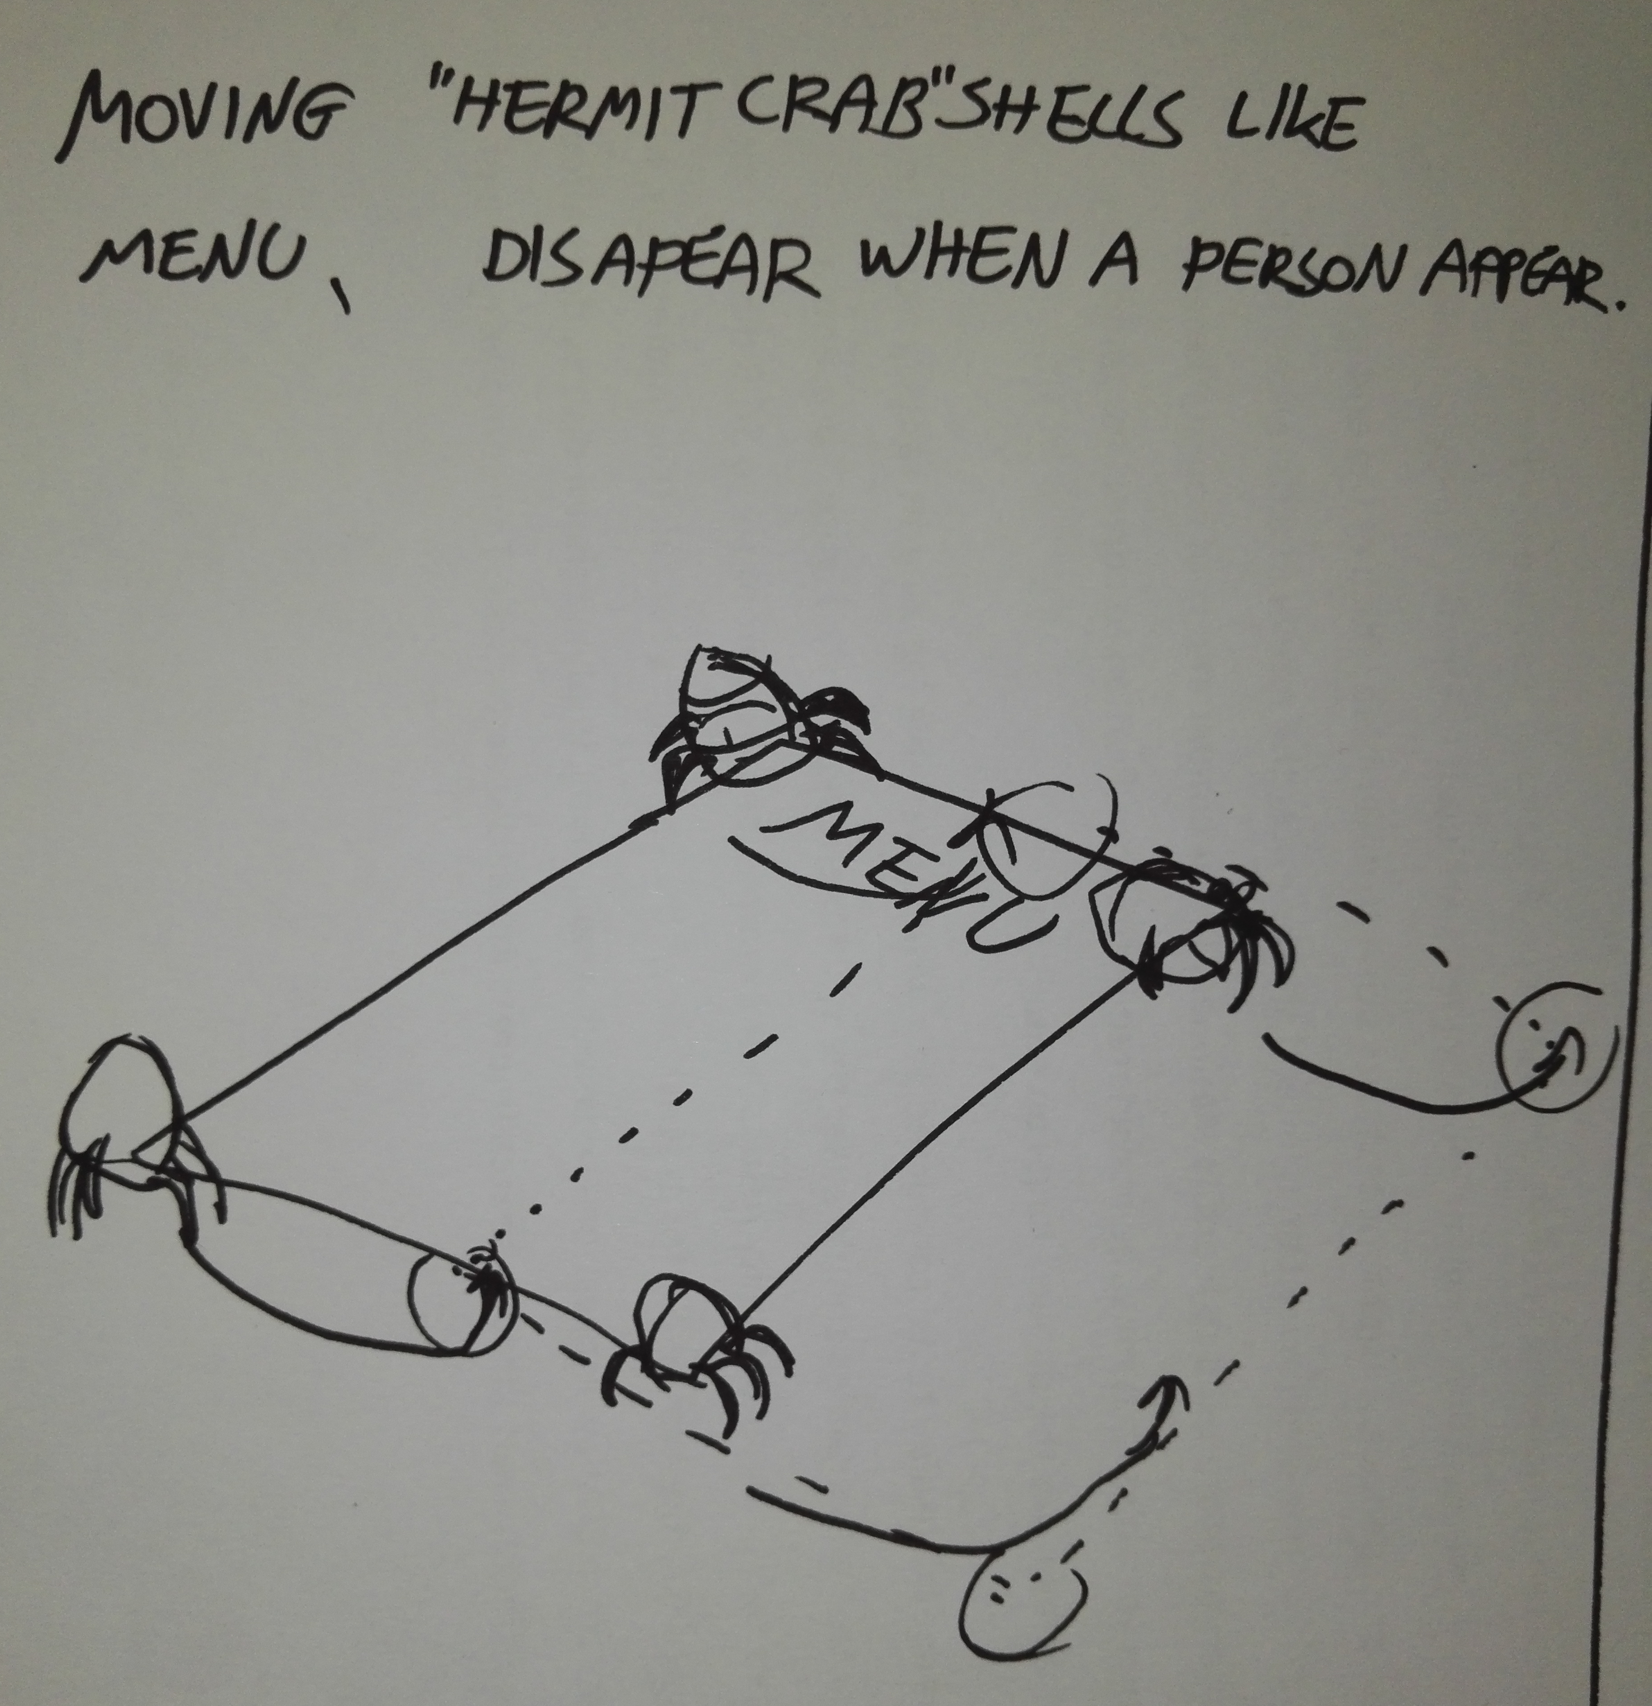
The ten alternatives
A robot that can drive small robotic “creatures” on the menu and, using a proximity sensor, make them stop their movements abruptly and hide in their shells.

Slide 11
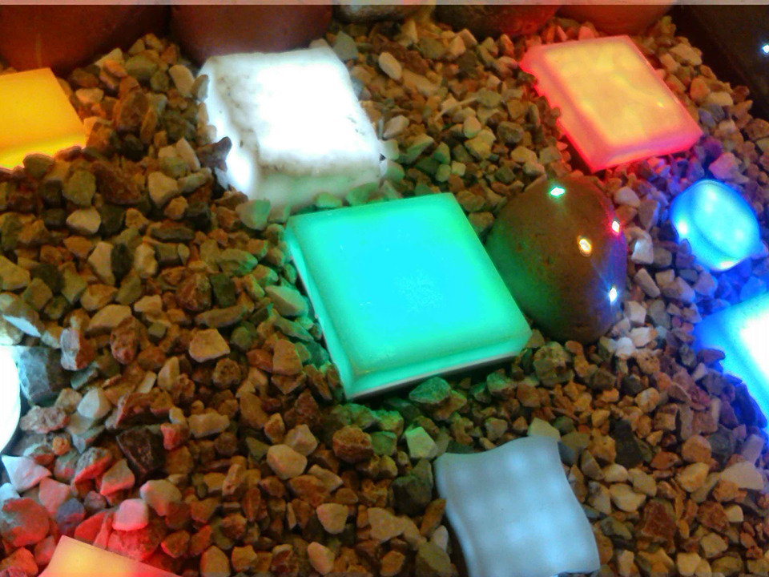
The final concept
A robot that can drive small robotic “creatures” on the menu and, using a proximity sensor, make them stop their movements abruptly and hide in their shells and then come out again slowly.

Slide 12
Inspiration

